Slide 1
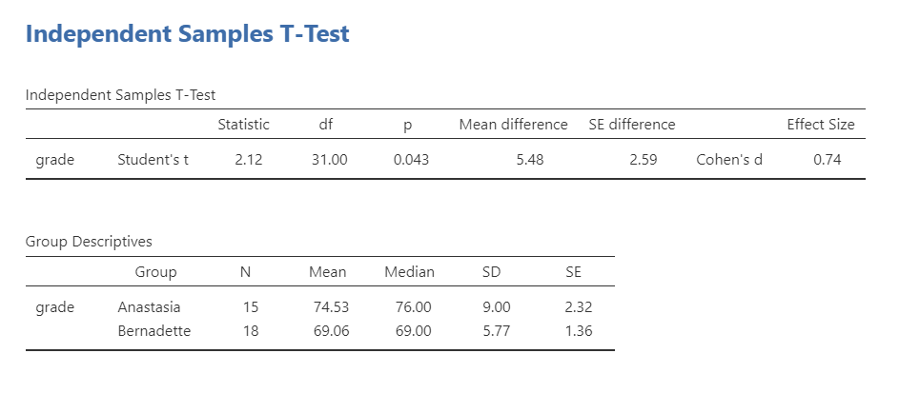
t (31) = 2.12, p = .043, d = .74.
Anastasia's students (M = 74.53, SD = 9.00, n = 15) had significantly higher grades than Bernadette's students (M = 69.06, SD = 5.77, n = 18).

Slide 2
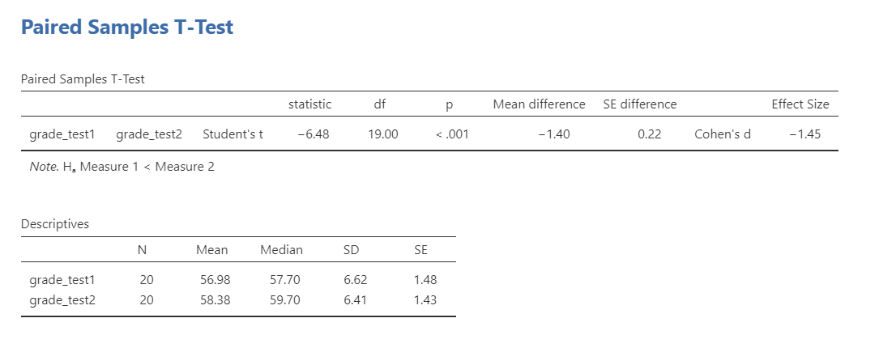
t(19) = 6.48, p < .001, d = 1.45
The 20 students in performed better on the second test (M = 58.38, SD = 6.41) than they did on the first test (M = 56.98, SD = 6.62).

